Slide 1
Solving Captcha image inputs using Convolutional Neural Networks
Karthik Sakthikanesan

Slide 2
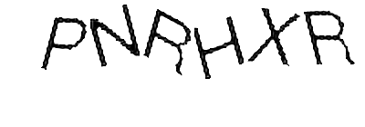
Objective
Given a captcha image, the model should return the actual characters associated with that particular image
Eg. For the image below, the model should return ‘PNRHXR’ as a string

Slide 3
Data
The data was obtained though a friend who was scraping amazon reviews for an NLP project. The Captcha images were obtained as a byproduct of this.
There are 10000 images.

Slide 4
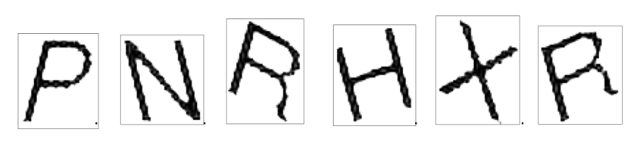
Methodology
The images in the training set have to be preprocessed. This is done by isolating the individual images in the image (using pytesseract and corrected manually occasionally).
Once that is done we should have individual images of each letter from A-Z.
The model is then trained to recognize these individual letters.

Slide 5
Methodology
When using the test set, the same thing is done without the label. The regions of each image are isolated and run through the model to get the final output.
All of this is run on an EC2 instance with 32GB of RAM. It originally didn’t work on an 8GB or 16GB instance. The next step would have been to reduce the image size.

Slide 6
QUESTIONS?

